Slide 1

Intro To Raspberry Pi
UTA EE Workshops

Slide 2
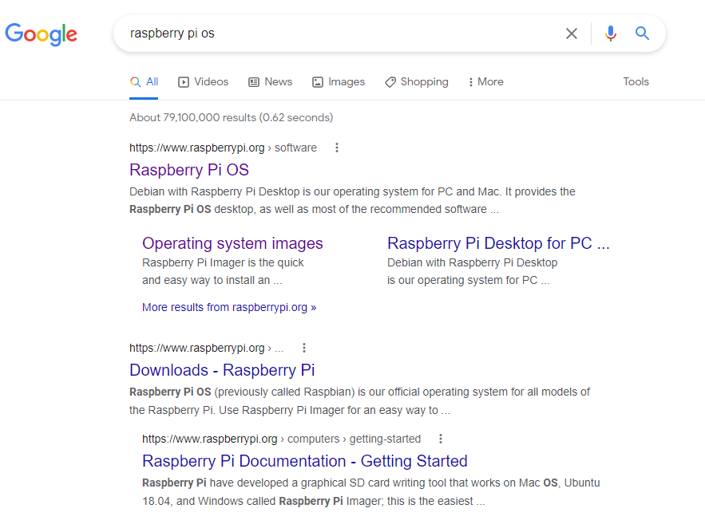
How to format the SD card
Search for Raspberry Pi OS

Slide 3
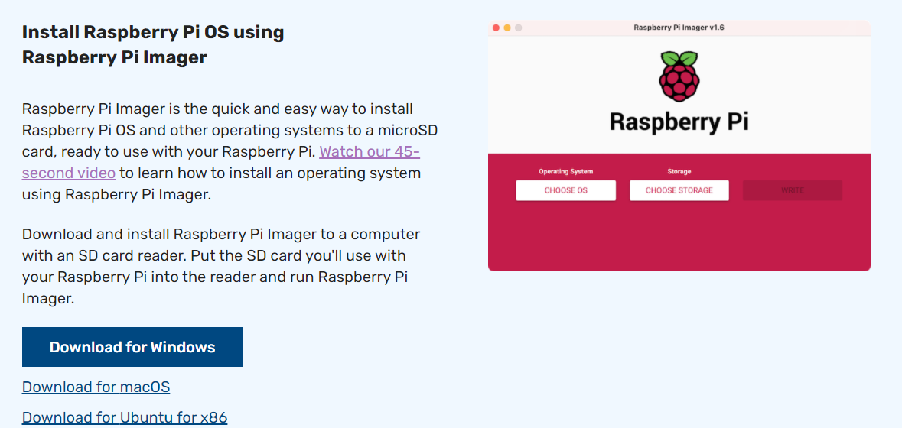
Download the installer for your system
This will install the latest SW
You have to download a huge file for previous versions.

Slide 4
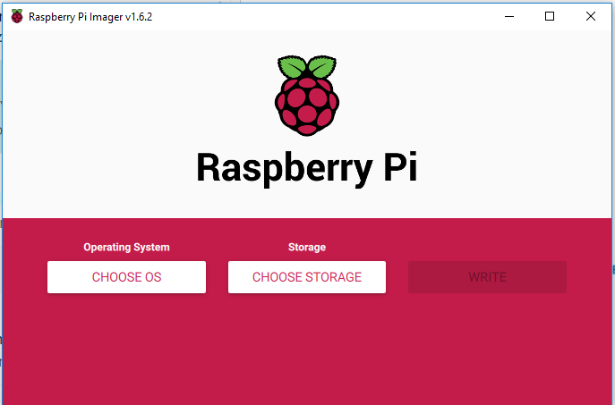
Open Raspberry Pi Imager

Slide 5
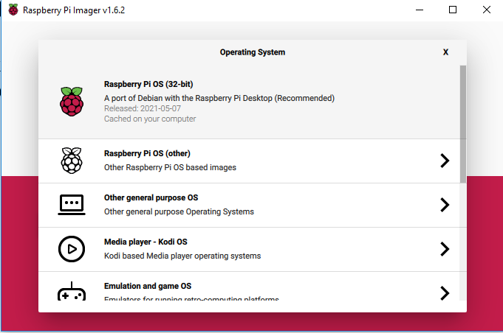
Choose the Raspberry Pi OS (32-bit)

Slide 6
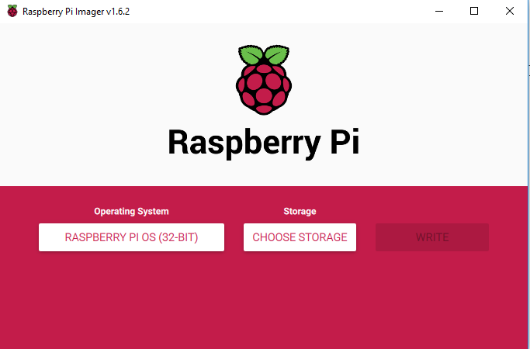
Plug the SD card into your computer and select Choose Storage.

Slide 7
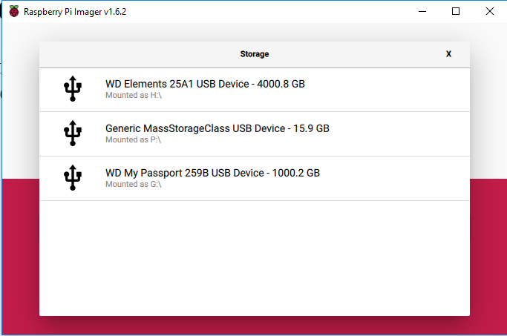
SD card is P:\ on this system. Verify in Explorer.

Slide 8
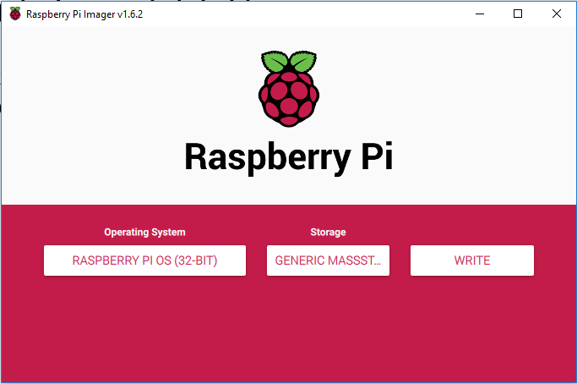
Click Write

Slide 9
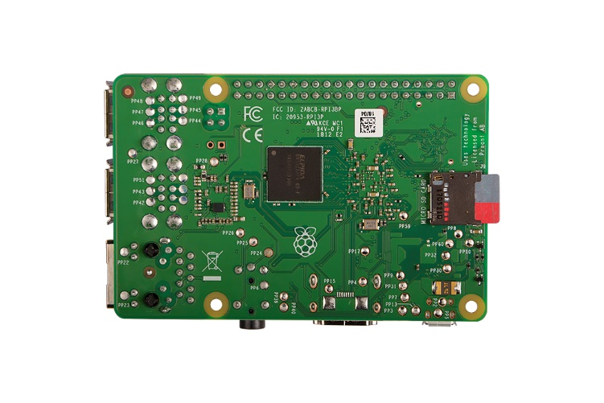
Insert Micro SD into Raspberry Pi.
Wrist-straps not required but touch metal on Rpi to dissipate ESD.
Be careful not to touch the Micro SD card pins.
Never place bare board on metal surface.

Slide 10
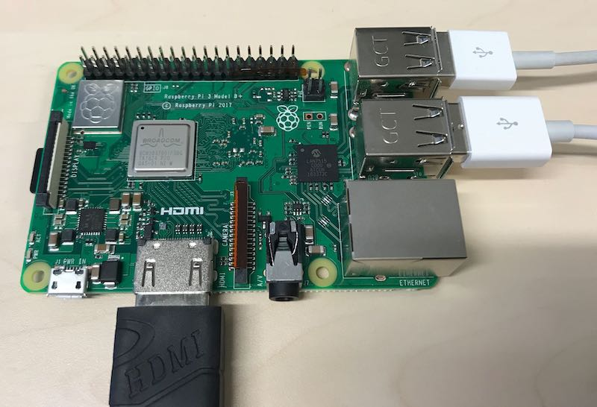
Connect Mouse, Keyboard and HDMI
Be gentle

Slide 11
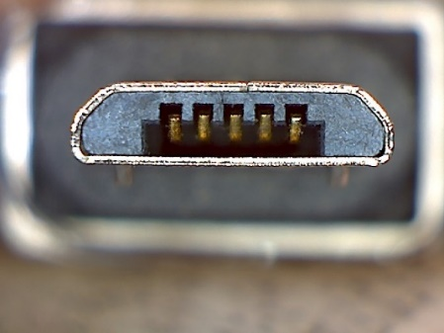

Connect Power
Again Gentle.
3B+ has directional USB Micro.
Rpi 4 has USB C and can plug in either way.
USB - Micro
USB - C

Slide 12
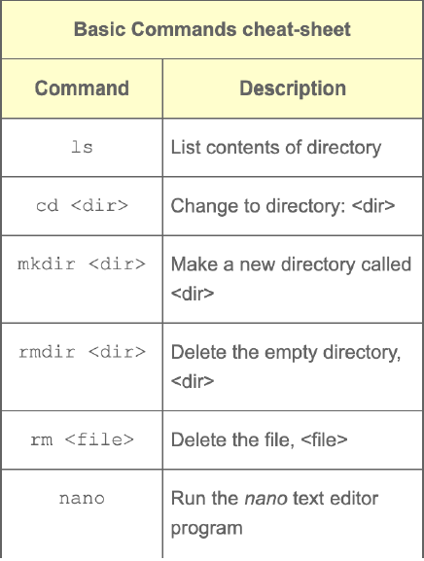
Terminal Commands
Basics

Slide 13
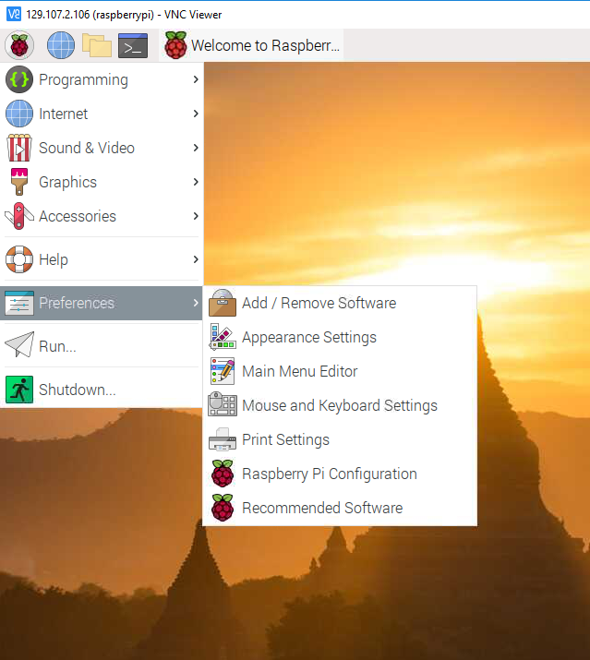
Don’t want a display, keyboard or mouse duct taped to your project?
Real VNC
This may not work on UTA’s Wi-Fi system.
Borrow the Network cable from the lab computer.
Download https://www.realvnc.com/en/connect/download/viewer/ and install on your computer
On the Pi: Preferences->Raspberry Pi configuration. Interfaces Tab: Enable VNC.

Slide 14
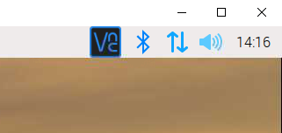
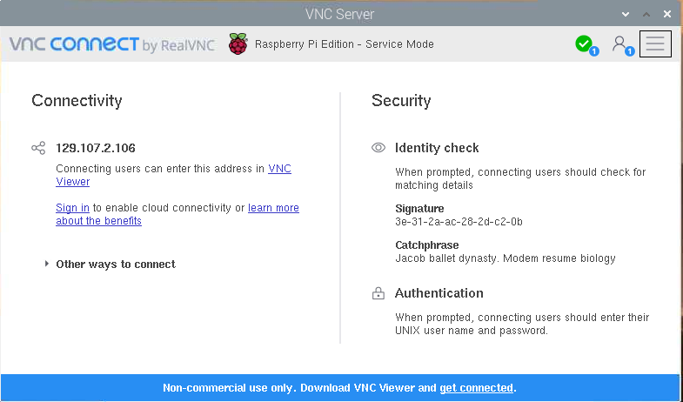
Remote control Baby!
Click the VNC button in the upper right
This will give you the Pi’s IP Address.
Open Real VNC on your laptop and enter the address.
Computer name is pi and default password is raspberry.
This should allow you to remotely control the raspberry Pi.

Slide 15
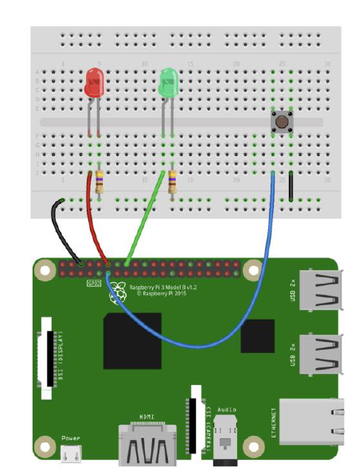
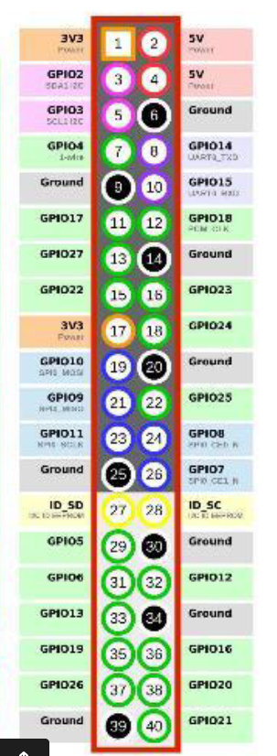
Blink an LED in Python.

Slide 16
import RPi.GPIO as GPIO
import time
#pin definitions
pwmPin = 18
ledPin = 23
butPin = 17
duty = 50
##GPIO setup ##
GPIO.setwarnings(False)
GPIO.setmode(GPIO.BCM) # BCM way of refering to pins
GPIO.setup(ledPin, GPIO.OUT)
GPIO.setup(pwmPin, GPIO.OUT)
GPIO.setup(butPin, GPIO.IN,pull_up_down=GPIO.PUD_UP)
pwm = GPIO.PWM(pwmPin, 1000) # PWM frequency = 200Hz
GPIO.output(ledPin, GPIO.LOW) # default off
pwm.start(duty) # start at 75%

Slide 17
try:
while 1:
if GPIO.input(butPin):
pwm.ChangeDutyCycle(duty)
GPIO.output(ledPin, GPIO.LOW)
#Pressed
else:
GPIO.output(ledPin, GPIO.HIGH)
pwm.ChangeDutyCycle(duty)
time.sleep(1.5)
GPIO.output(ledPin, GPIO.LOW)
pwm.ChangeDutyCycle(100)
time.sleep(1.5)
except KeyboardInterrupt:
pwm.stop()
GPIO.cleanup()

